Slide 1
Volunteer Management System
Presented by Team SE18-08S

Slide 2
Agenda
Project Revisit
Use Case Modeling
Software Architecture
Demo of Prototype
Transition Strategy
Project Progress
Challenges & Problems
Q & A

Slide 3
Project Revisit
Purpose: To build a web-based solution to facilitate the process of volunteer registration, project management till retention.
Requirement overview:
Volunteer Management
Staff Management
Project Management
Itinerary Management
Administration

Slide 4
Agenda
Project Revisit
Use Case Modeling
Software Architecture
Demo of Prototype
Transition Strategy
Project Progress
Development Plan
Challenges & Problems
Q & A

Slide 5
Use Case Modeling
Use Case Model Survey:
21 use cases
7 actors
Sample Use Cases:
Generate Certificate
Search Project Member
Assign Role to Project Member

Slide 6
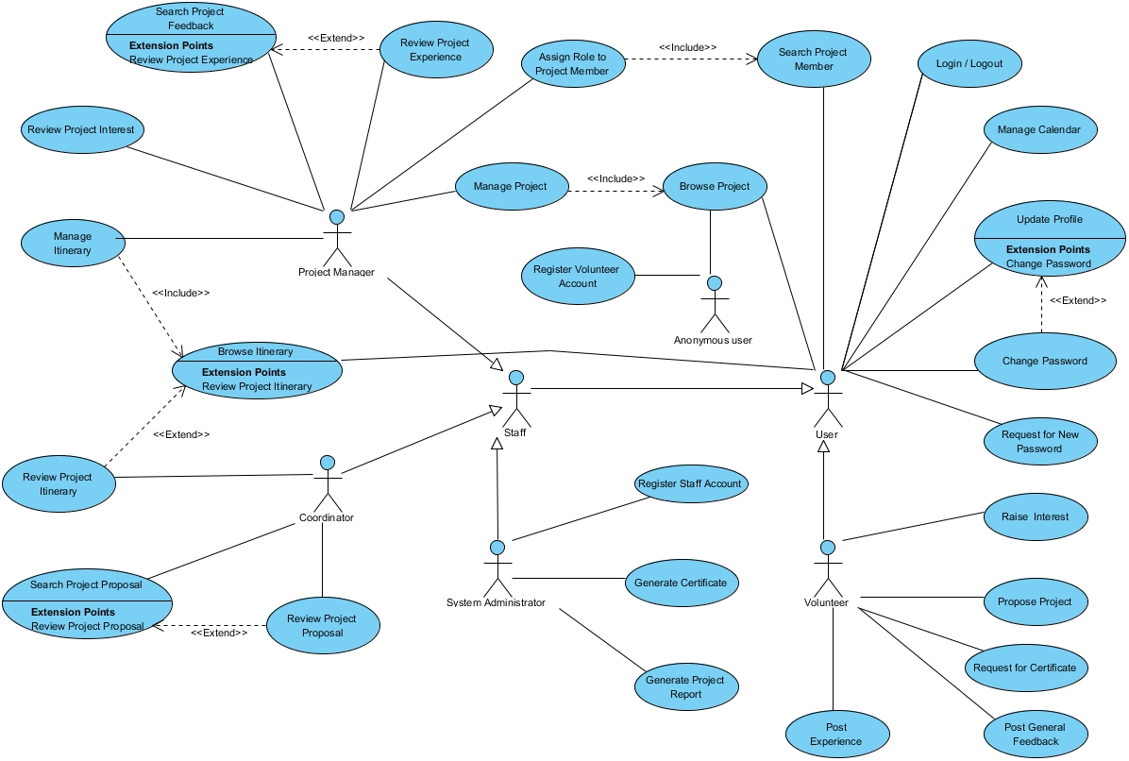

Slide 7
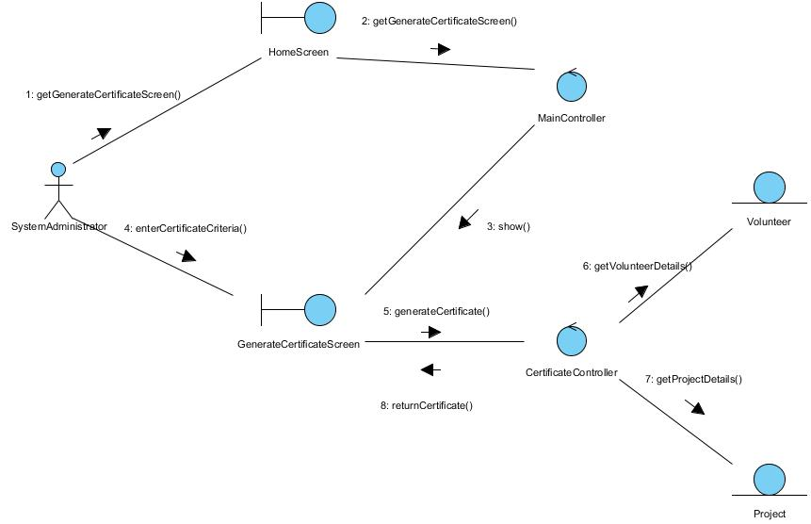
Use Case Modeling Sample 1: Generate Certificate
Description: Let System Administrator to generate certificate requested by volunteers.
Interaction diagram

Slide 8
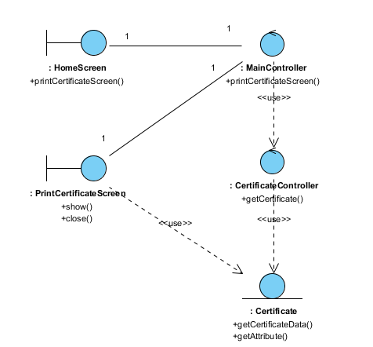
Use Case Modeling Sample 1: Generate Certificate
Class diagram

Slide 9
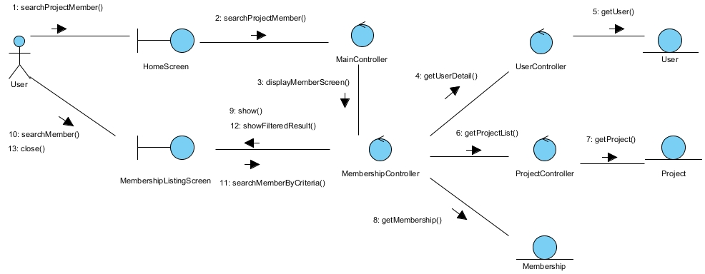
Use Case Modeling Sample 2: Search Project Member
Description: Let user search and view the member list of a project.
Interaction diagram

Slide 10
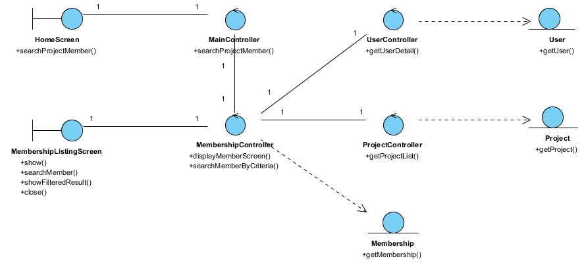
Use Case Modeling Sample 2: Search Project Member
Class diagram

Slide 11
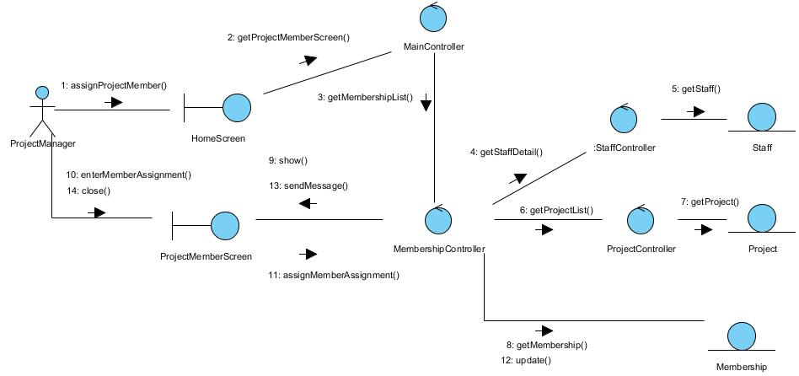
Use Case Modeling Sample 3: Assign Role To Project Member
Description: Let Project Manager assign the roles to project members.
Interaction diagram

Slide 12
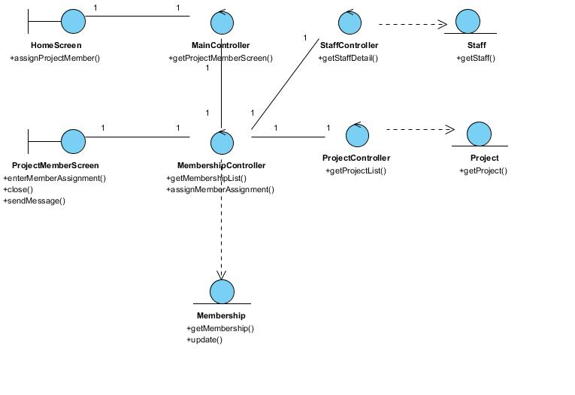
Use Case Modeling Sample 3: Assign Role To Project Member
Class diagram

Slide 13
Agenda
Project Revisit
Use Case Modeling
Software Architecture
Demo of Prototype
Transition Strategy
Project Progress
Development Plan
Challenges & Problems
Q & A

Slide 14
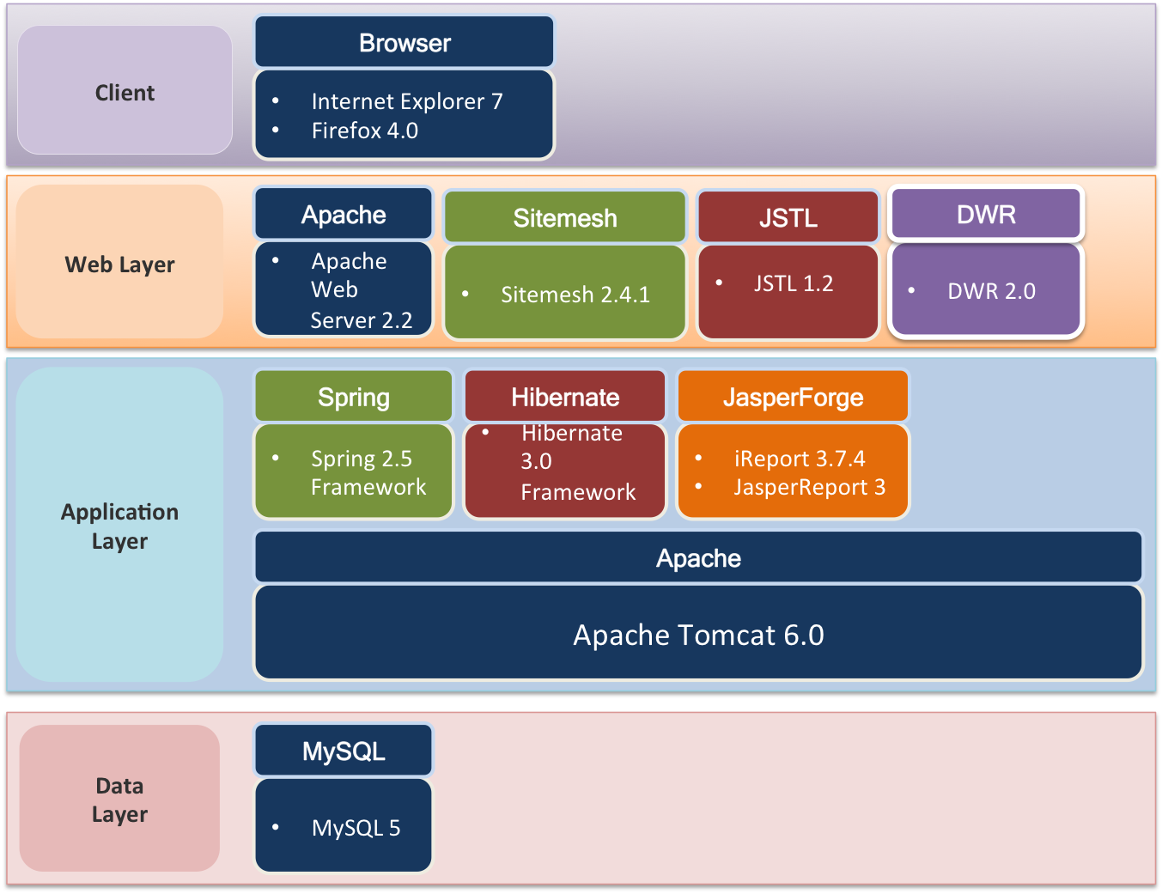
Software Architecture Technologies & Components

Slide 15
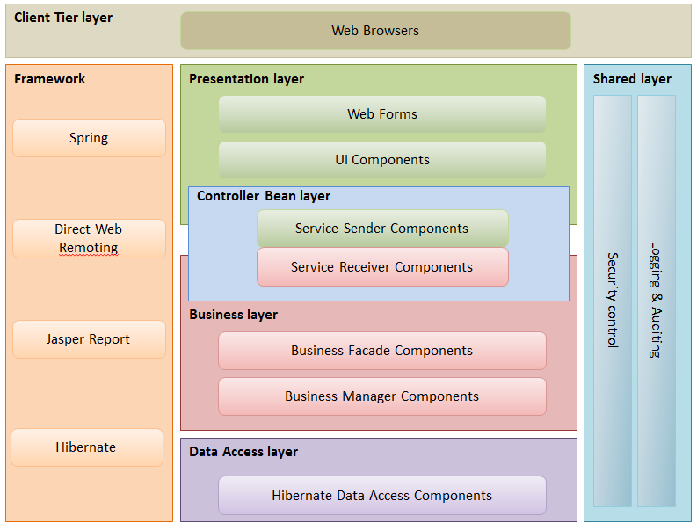
Software Architecture Logical Application Architecture

Slide 16
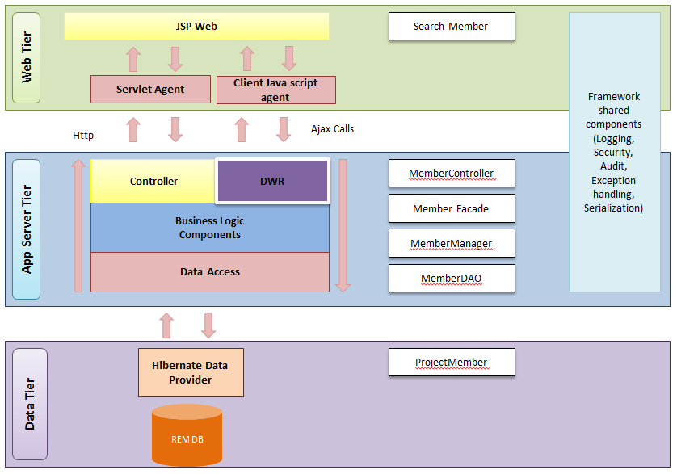
Software Architecture Logical Application Sample

Slide 17
Agenda
Project Revisit
Use Case Modeling
Software Architecture
Demo of Prototype
Transition Strategy
Project Progress
Development Plan
Challenges & Problems
Q & A

Slide 18
Demo of Prototype
Volunteer Management System

Slide 19
Demo of Prototype
Technical Prototype:
Purpose:
Confirm system components working
Confirm feasibility and reusability
Result:
Verified and accepted within team
User Interface Prototype
Purpose:
Review usability
Confirm UI design with user
Result:
Verified and accepted by user representative

Slide 20
Agenda
Project Revisit
Use Case Modeling
Software Architecture
Demo of Prototype
Transition Strategy
Project Progress
Development Plan
Challenges & Problems
Q & A

Slide 21
Transition Strategy Analysis to Design
RUP workflows & process
Prototyping
Use Case Modeling
Use Case Realisation Report
High-level System Design
Detailed Design
Implementation
Testing
Project Management

Slide 22
Transition Strategy Analysis to Design
No | Task | Description | In-Charge
1 | High level design | Software architecture Prototype | Architect Design team
2 | Detailed Design Specs | Use Case Realisation Report (Designed) Guidelines & standards | Architect Design team
3 | Implementation | Code Unit-test | Development team
4 | Testing | Test script (SIT & UAT) Test plan Test result | Test lead Test team
5 | Project Management | Development plan Project reports User guide | Project Manager QA Manager Business Analyst

Slide 23
Agenda
Project Revisit
Use Case Modeling
Software Architecture
Demo of Prototype
Transition Strategy
Project Progress
Development Plan
Challenges & Problems
Q & A

Slide 24

Project Progress
Activity | Planned Start Date | Planned End Date | Actual Start Date | Actual End Date | Task Status
Analysis Modelling
Produce Functional Specs - UCMS and UCRR (Analysis) | 10 Apr 2011 | 10 Aug 2011 | 12 Apr 2011 | 18 Aug 2011
Produce High-level Design Specifications | 1 Jul 2011 | 10 Aug 2011 | 25 May 2011 | 10 Aug 2011
Produce Prototyping Study Report | 10 Apr 2011 | 12 Jun 2011 | 01 May 2011 | 18 Aug 2011
Prepare Second Audit & Presentation | 01 Aug 2011 | 12 Aug 2011 | 01 Aug 2011 | 12 Aug 2011
Design Modelling
Produce detailed DS | 18 Aug 2011 | 15 Sep 2011 | - | - | OPEN

Slide 25
Agenda
Project Revisit
Use Case Modeling
Software Architecture
Demo of Prototype
Transition Strategy
Project Progress
Development Plan
Challenges & Problems
Q & A

Slide 26
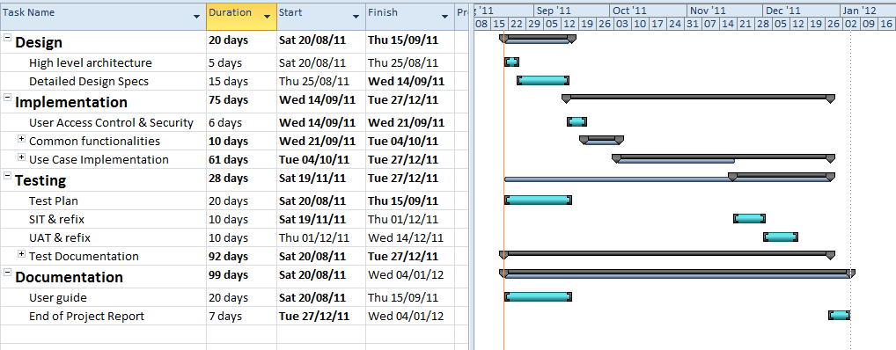
Development plan

Slide 27
Agenda
Project Revisit
Use Case Modeling
Software Architecture
Demo of Prototype
Transition Strategy
Project Progress
Development Plan
Challenges & Problems
Q & A

Slide 28
Challenges & Problems
No | Challenge | Description | Solution
1. | Communications | Difficulty to gather all members for discussions. | Online meeting via Skype To fix a weekly meeting time
2. | Task Control | Visibility of task status. | To log time log Regular status update
3. | Standard & Quality variance | Different familiarity level within the team | Guidance from lead Peer reviews Code walkthrough Pair development

Slide 29
Agenda
Project Revisit
Use Case Modeling
Software Architecture
Demo of Prototype
Transition Strategy
Project Progress
Challenges & Problems
Q & A

Slide 30
Question & Answer

